Slide 1



Realtime Object Recognition using Azure AI and Microsoft Fabric
Sai Prudhvi Neelakantam
Microsoft Fabric Global Online Conference
2024

Slide 2










Sai Prudhvi Neelakantam
Data engineer consultant, Amesto analytics
Masters in Business Analytics
Geek in Data & AI
Currently geeking:
Free time:
Outdoors nature
Fitness
Board games
in/saiprudhvineelakantam
geekindata.com
Oslo
Norway
sai@geekindata.com

Slide 3
Realtime Object Recognition using Azure AI and Microsoft Fabric
Sai Prudhvi Neelakantam
Microsoft Fabric Global Online Conference
2024

Slide 4




Realtime Object Recognition Use Case Airport Environment
Azure AI
Services
Microsoft
Fabric

Slide 5
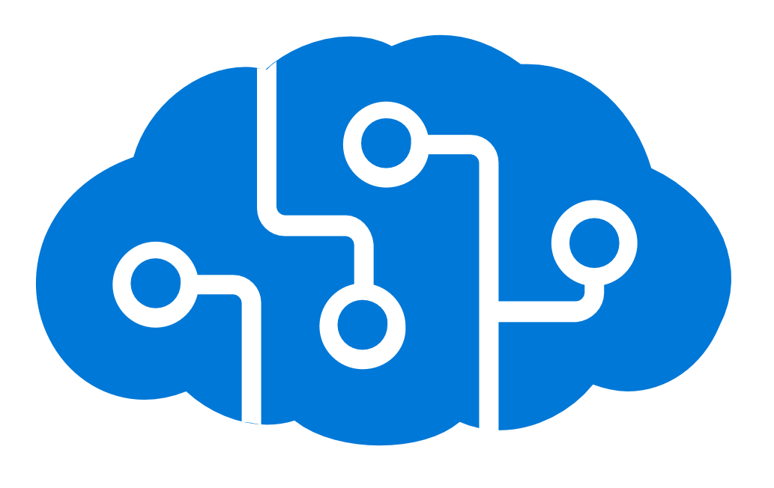
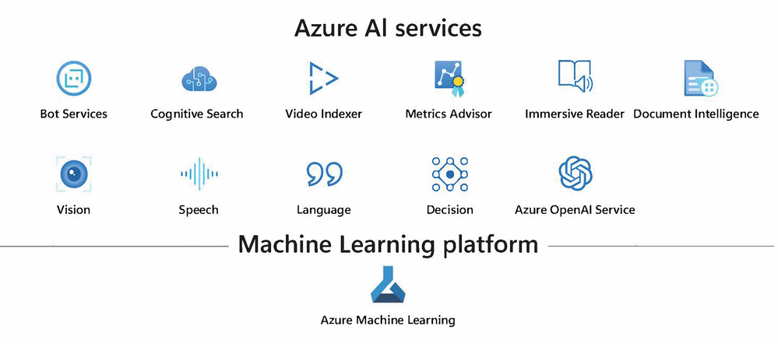
Azure AI Services
Azure AI Studio

Slide 6
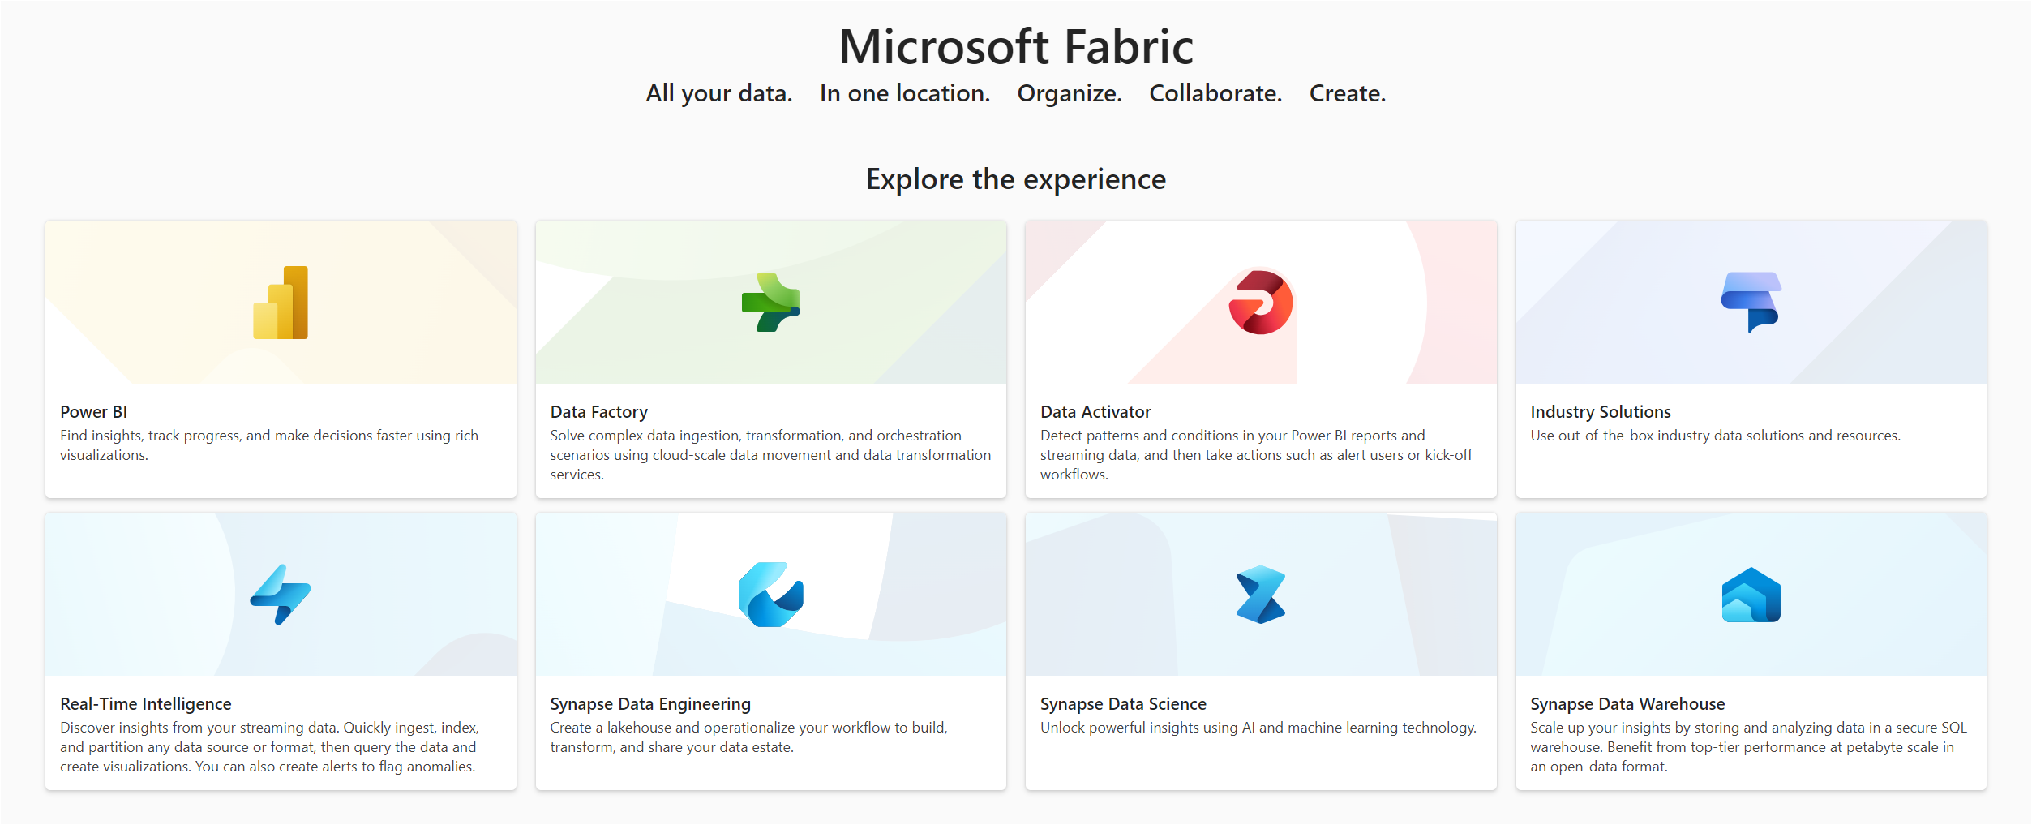
Microsoft Fabric

Slide 7
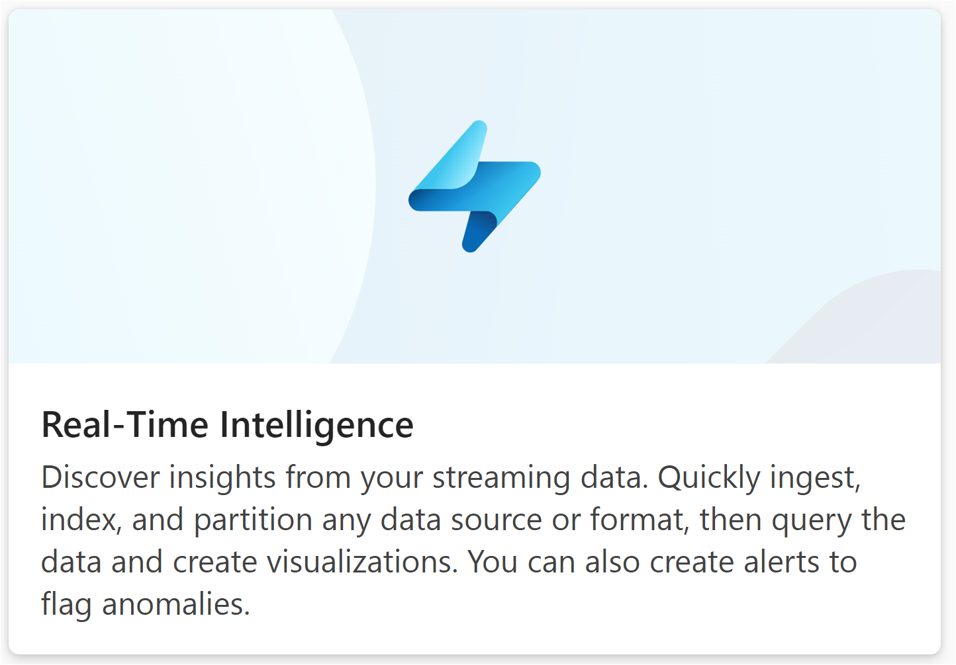
Microsoft Fabric

Slide 8
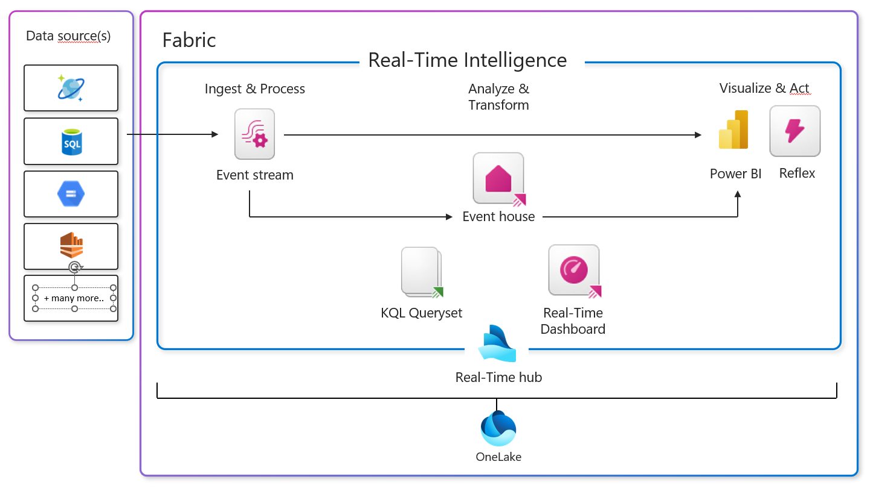
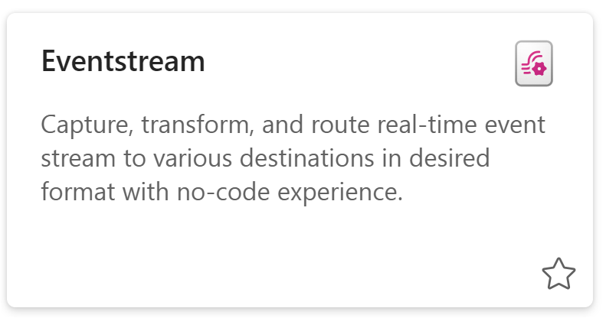
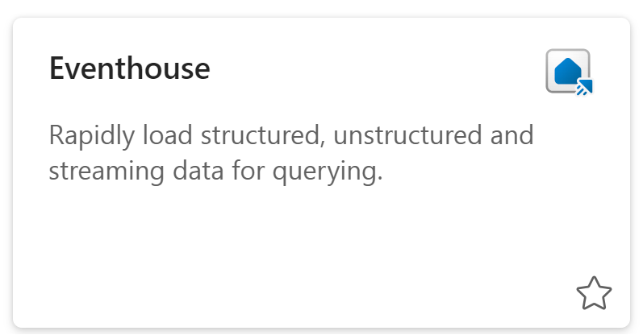
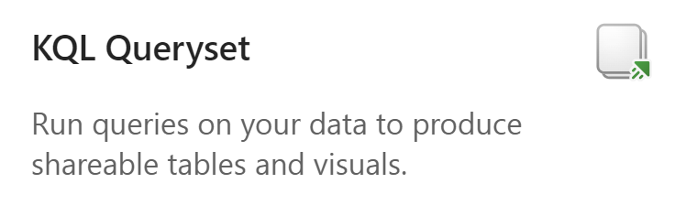
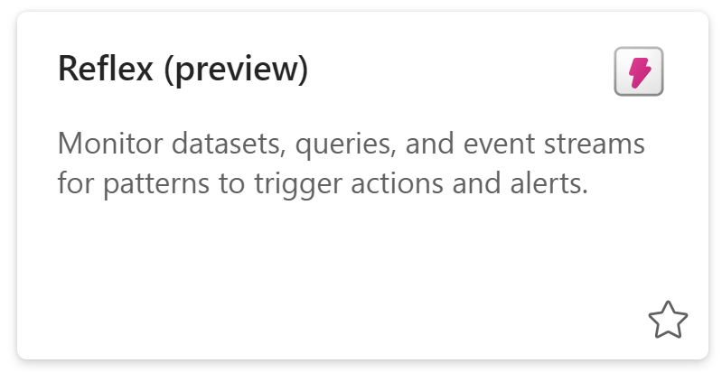
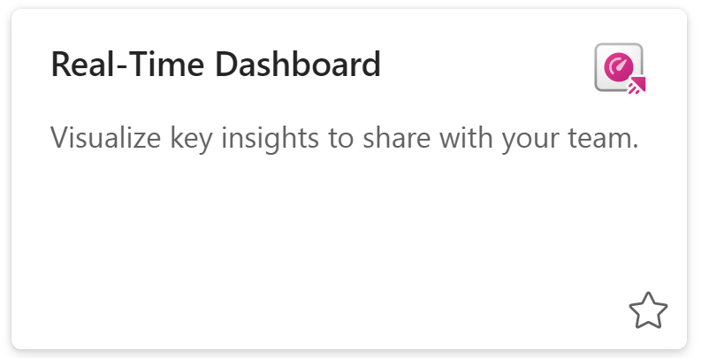

Items in Fabric Real-Time Intelligence

Slide 9
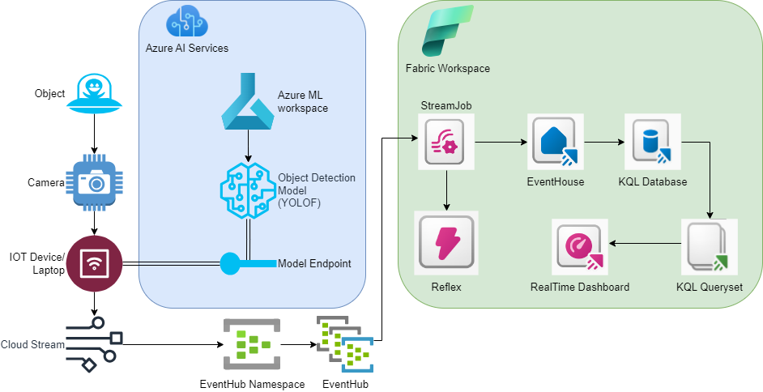
Architecture

Slide 10
AI/ML Model YOLOF (You Only Look One-level Feature)
Training and
Evaluation
Dataset: Trained on the widely-used COCO dataset.
Accuracy: Achieves a respectable box AP of 37.5.
User-Friendly
Easy to Use: Provides scripts for real-time and batch inference, and for finetuning on your own dataset.
Visual Results
Clear Outputs: Detects objects in images with clear bounding boxes, labels, and confidence scores.
Why Choose YOLOF?
Simplicity: Uses a single layer for detection, making it easier and faster.
Performance: Delivers high accuracy and speed.
Efficiency: Faster than many other models, like RetinaNet and YOLOv4, and requires less training time.

Slide 11
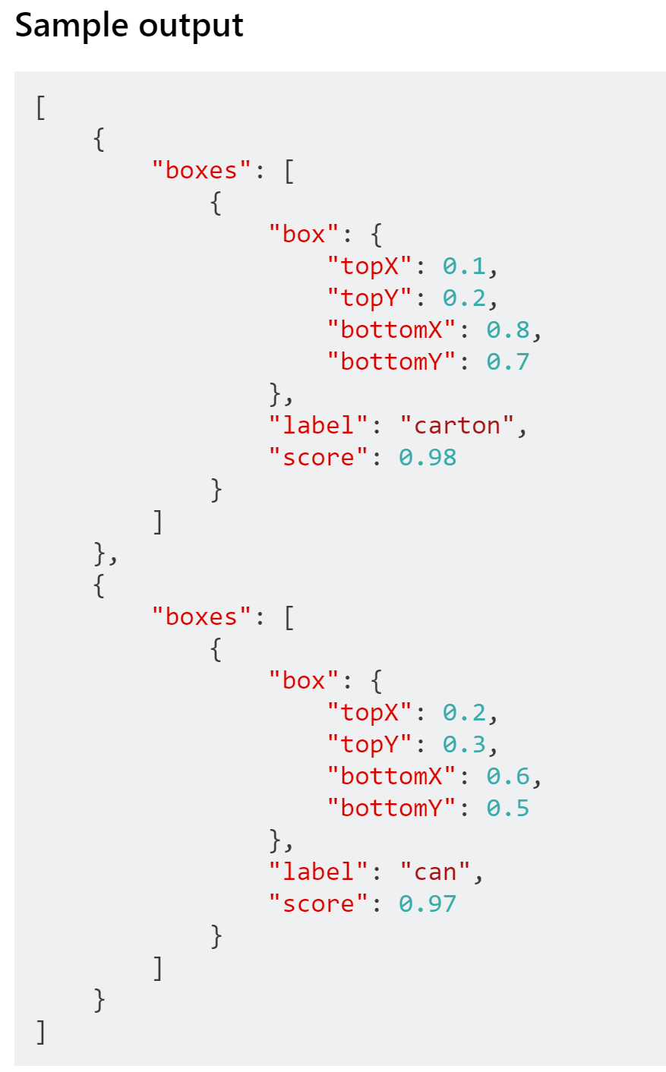
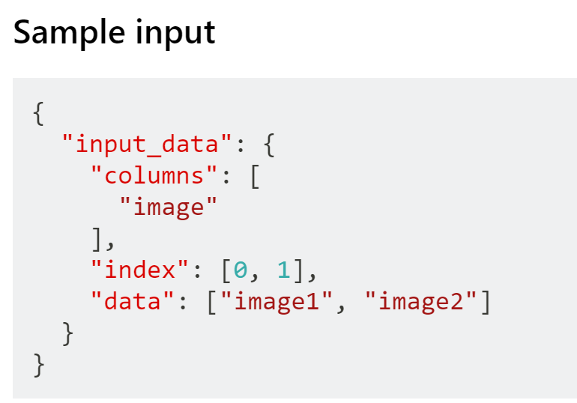
Sample Input and Output for YOLOF (You Only Look One-level Feature)

Slide 12
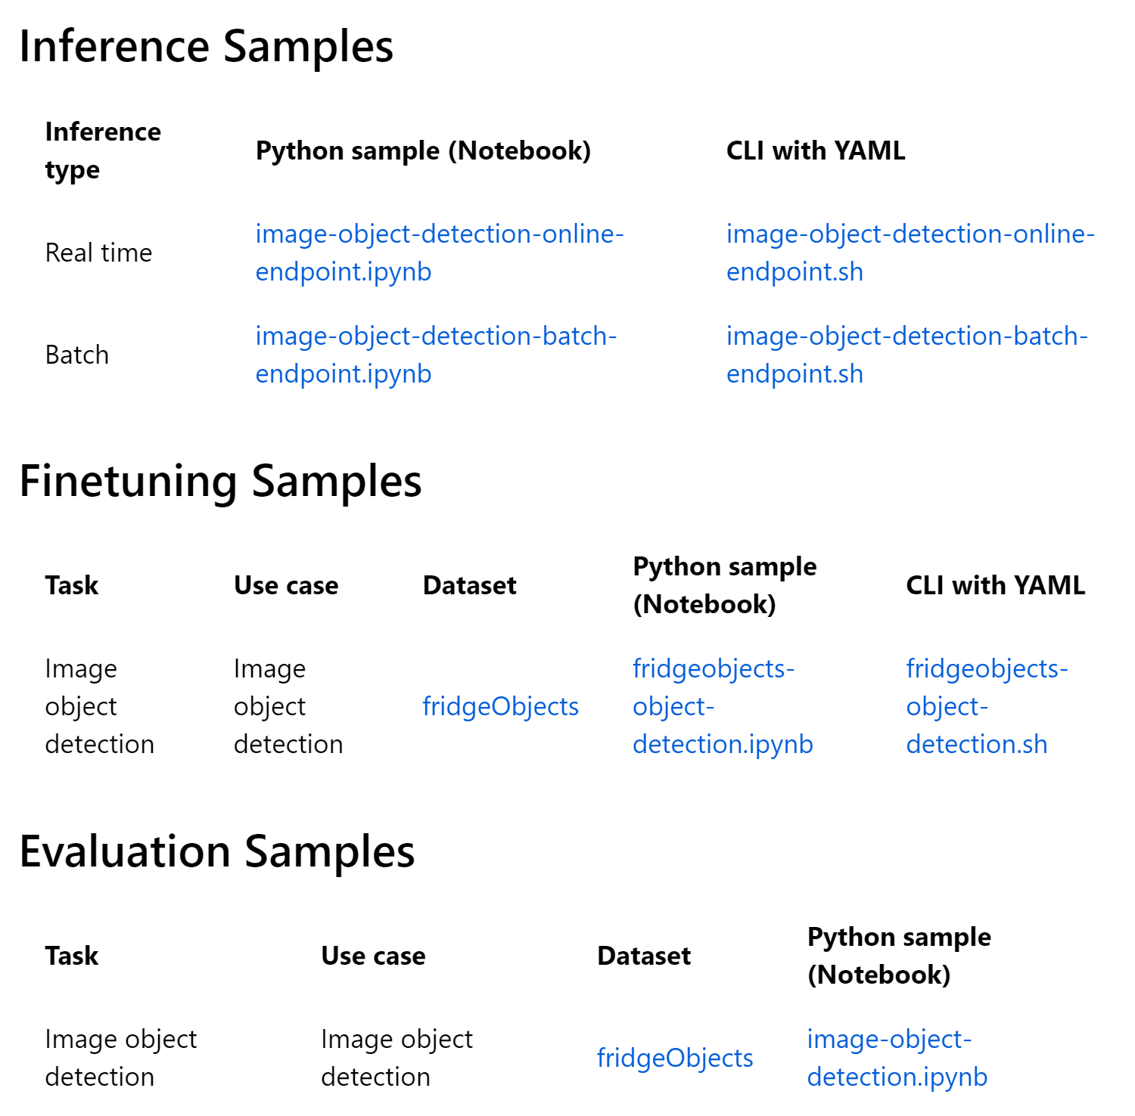
Prebuilt notebooks for model deployment in Azure ML

Slide 13
Architecture Quick check

Slide 14
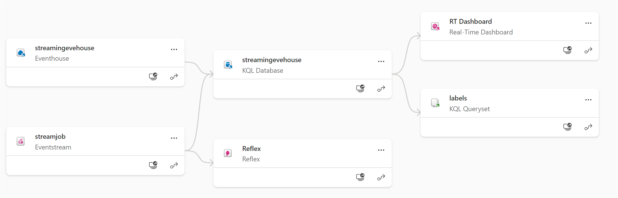
Fabric Realtime Intelligence Lineage

Slide 15
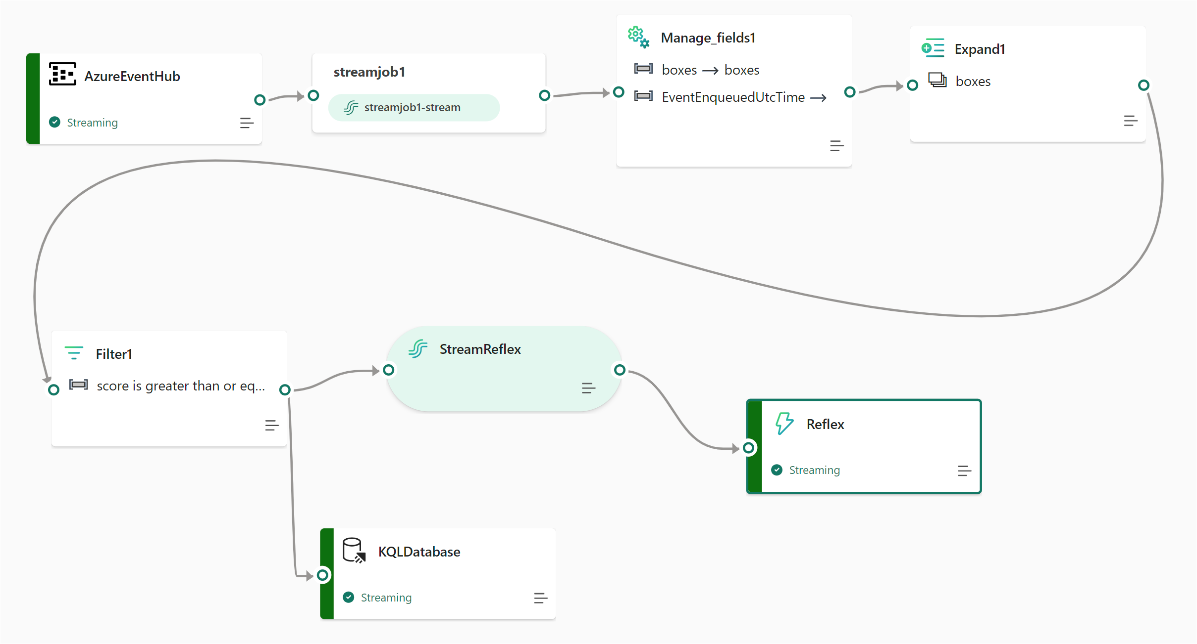
Fabric StreamJob

Slide 16
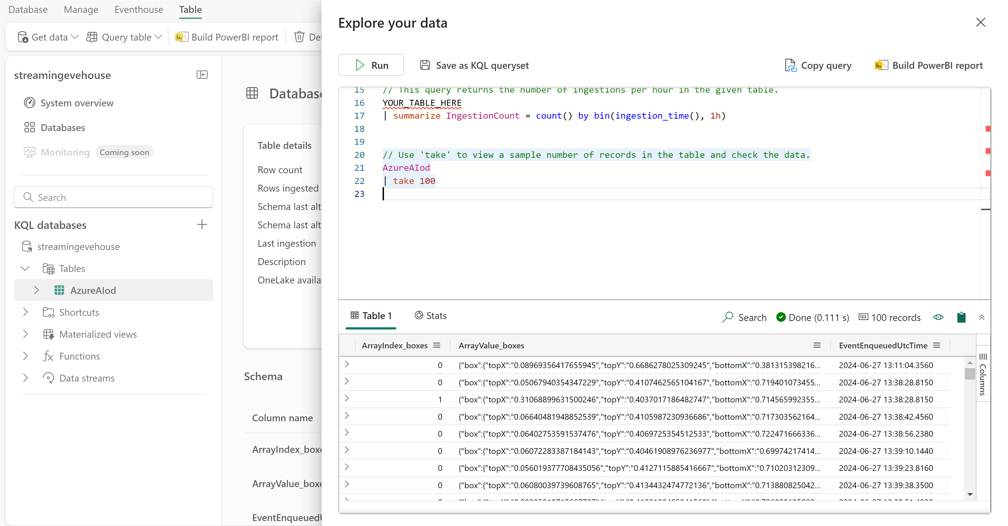
KQL Database in Eventhouse

Slide 17
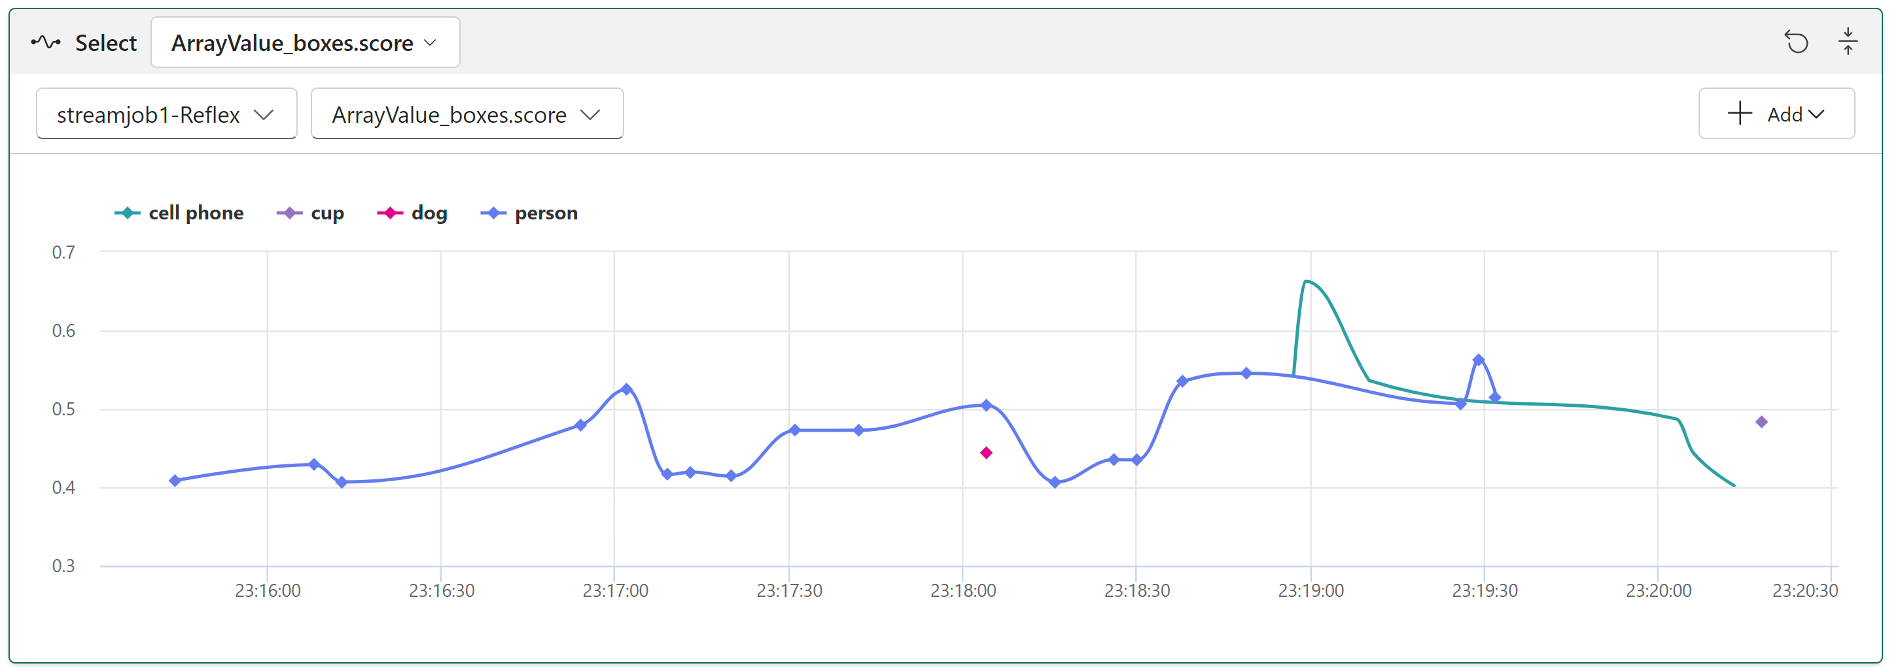
Fabric Reflex

Slide 18
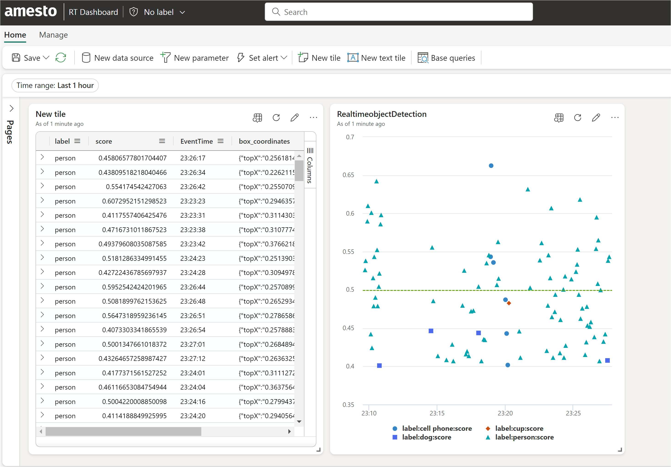
Fabric Realtime Dashboard

Slide 19
Recap

Slide 20

Thank You!
Microsoft Fabric Global Online Conference 2024
Sai Prudhvi Neelakantam
in/saiprudhvineelakantam
geekindata.com
sai@geekindata.com

